Slide 1
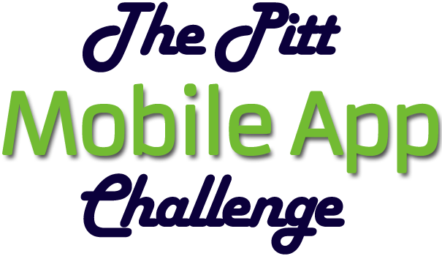

“CODE IT” CATEGORY
BABL
Notes:
[Jinx takes the stage.]

Slide 2
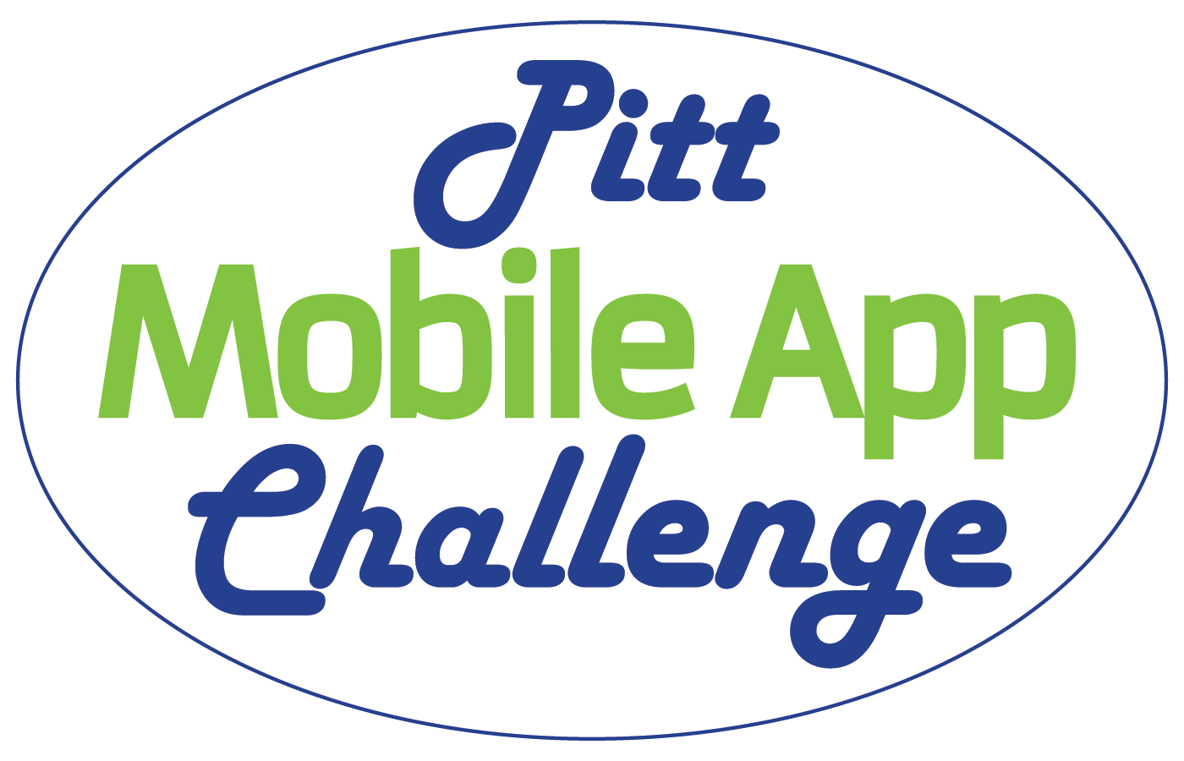
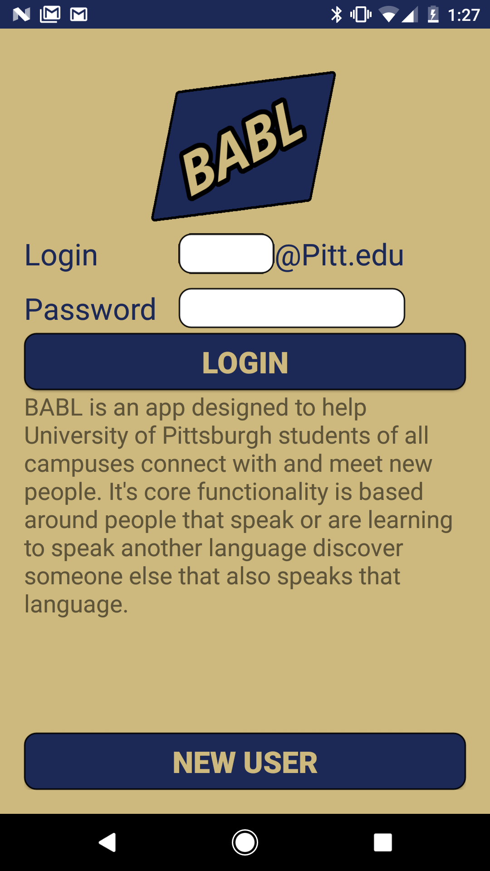
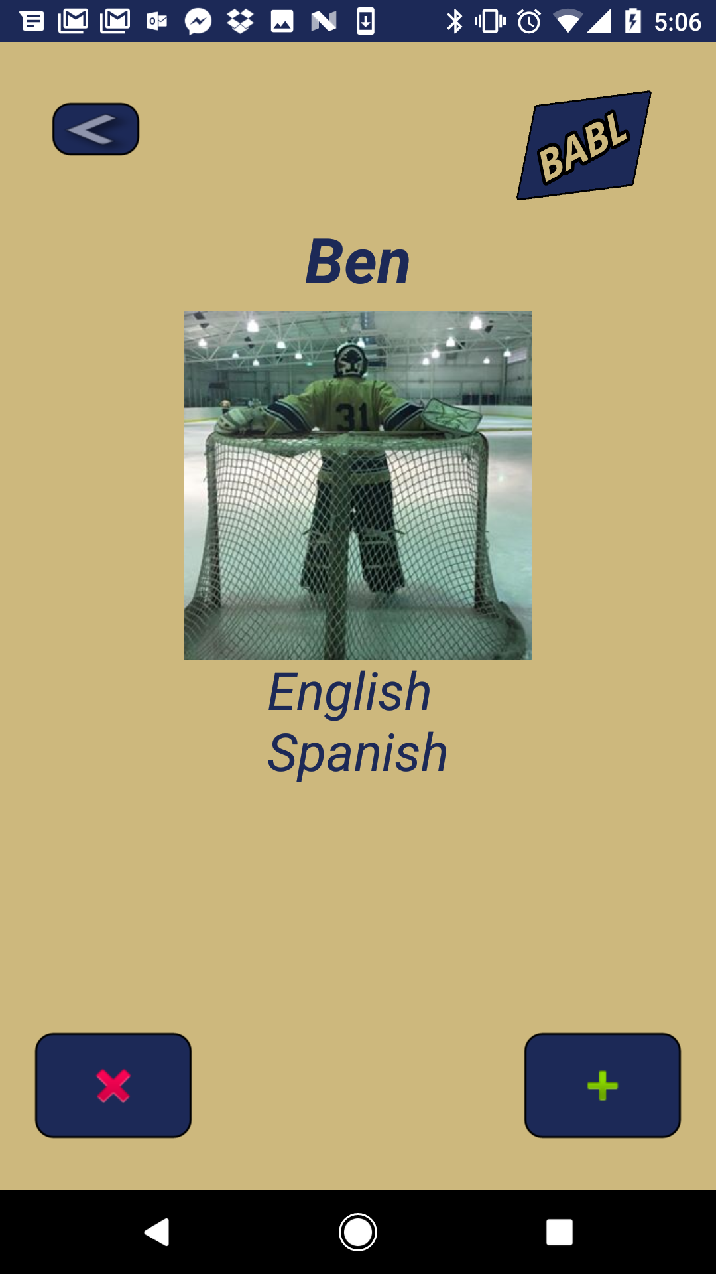
BABL: Overview
BABL is a Simple, Clean, and User-Friendly app coded in Java for Android Devices. It’s core functionality is based around helping Pitt students of all campuses meet and connect with other students for the purpose of speaking or learning to speak bilingually.
BABL acts as means of increasing cultural understanding and intellectual diversity on campus by attempting to diminish communication barriers between students.
Finds Pitt students
where at least
one language
matches your Selection
Accept
or
Decline

Slide 3
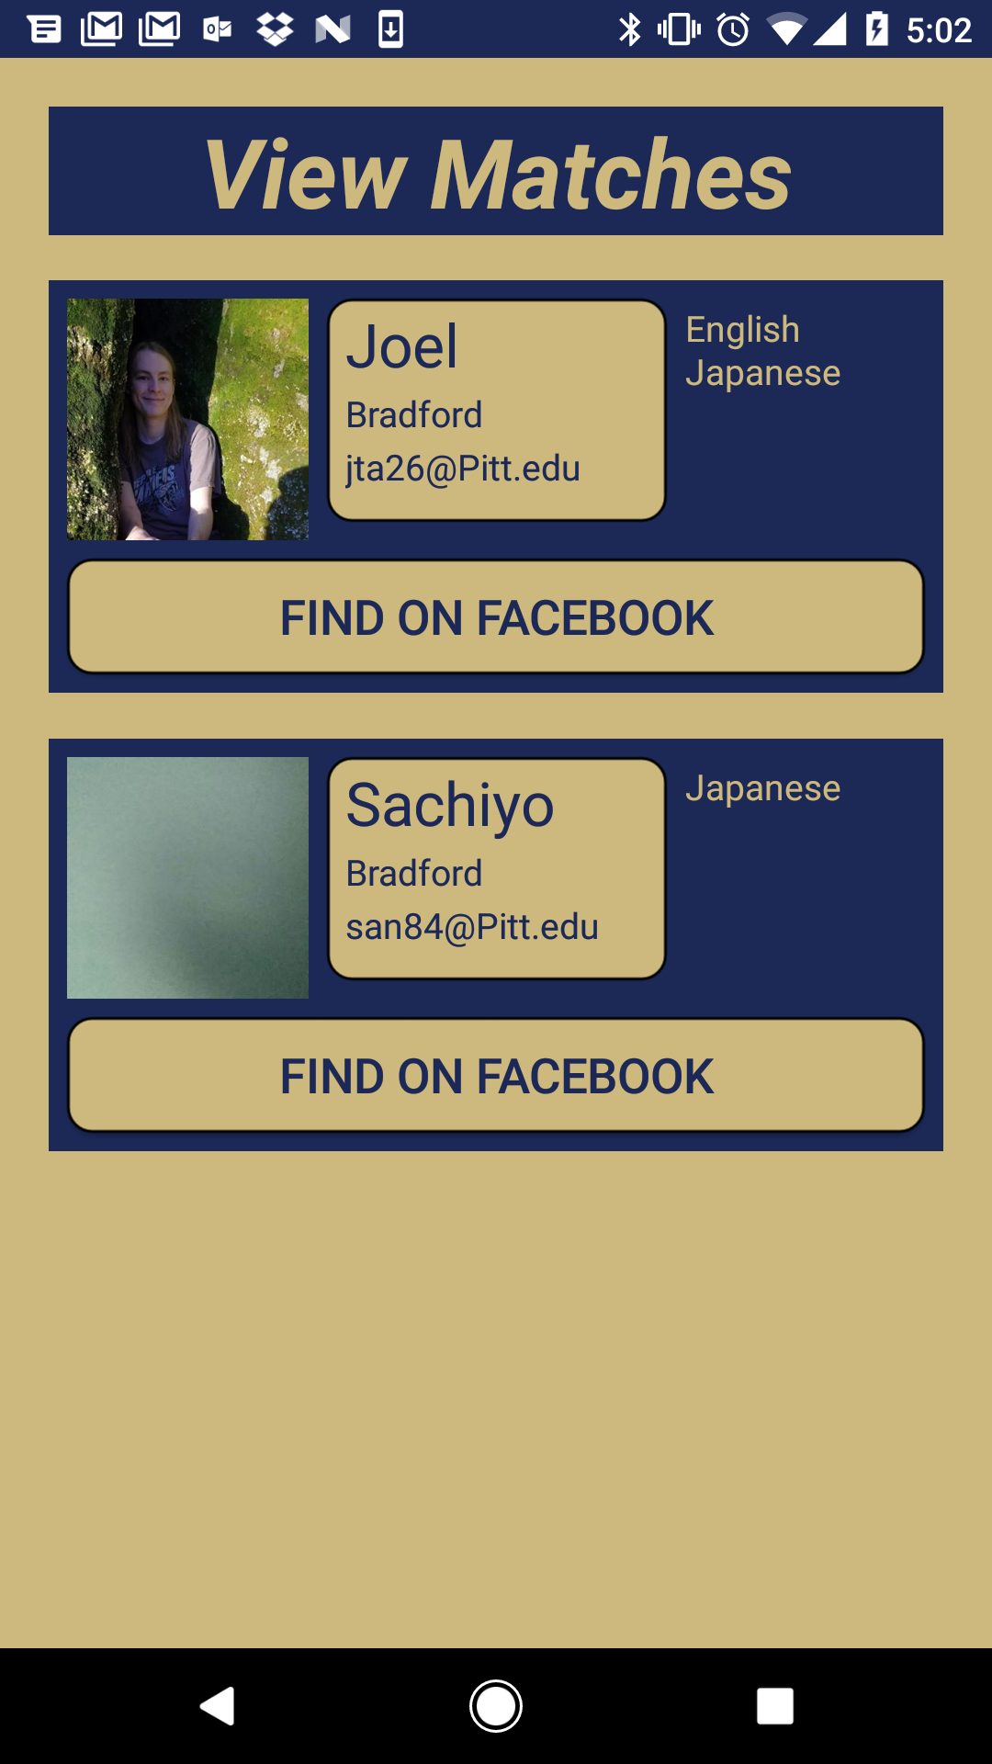
BABL: Marketing Summary
Our target market is Android Users at the University of Pittsburgh main and regional campuses that speak or want to speak bilingually.
BABL is unique because it ties Pitt Usernames to Facebook accounts, and uses that as means of connection and communication. It matches users up together that speak the same language, and are on the users chosen campuses.
Touch to
Open Match’s
Facebook

Slide 4
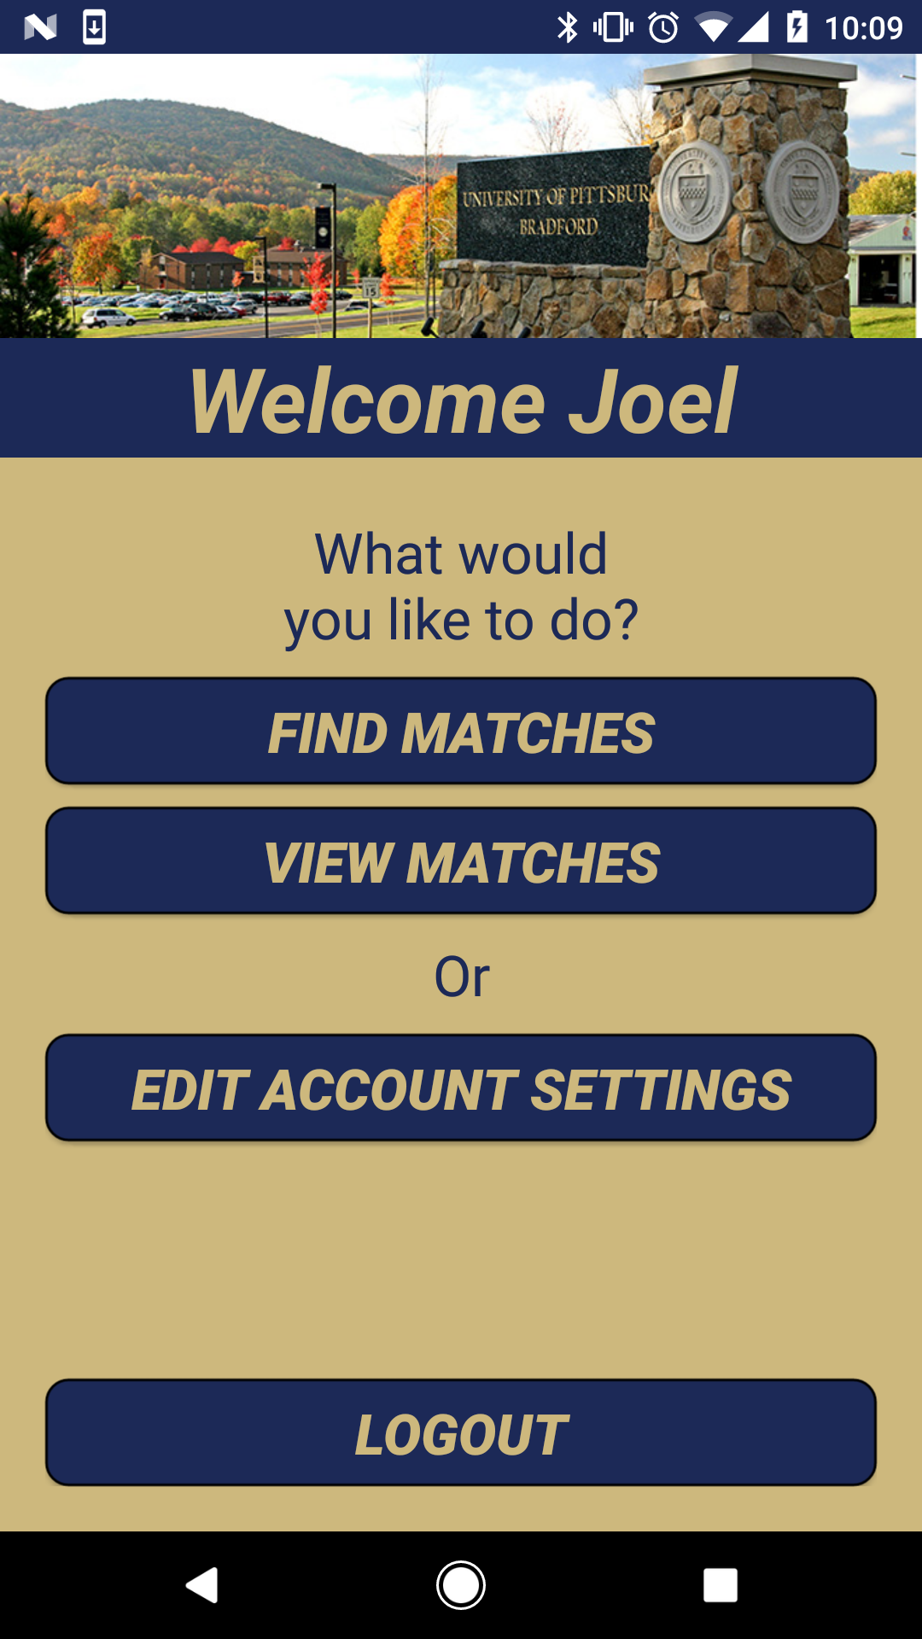
BABL: Technology Summary
BABL utilizes the idea of matching, and the publicly available Facebook profiles to help students get to know other people based on which language they wish to speak. It is able to filter users by campus based on your personal preferences. What makes BABL awesome is the tech behind the scenes. It has full Facebook integration, asynchronous tasking, and password encryption. BABL’s user data storage, matching algorithm, and stored procedures are all done using Microsoft SQL Server and are hosted on Amazon Web Services.
Banner Image
Changes Based
On Campus

